Slide 1
OBJECTIVES
  Reduce the amount of proposed tax increase we are asking from our citizens from .35 to .25 while maintaining current service levels.
  Where possible improve the City’s debt position, reduce risk, and save on future net interest costs by making use of the City’s Balance Sheet.
  Reduce risk on Music Center Debt by providing a TIF revenue stream to fund debt service that is not reliant upon future build out.
1

Slide 2
2025 PLAN SUMMARY
REDUCE amount of the income tax increase we are asking from our citizens from .35 to .25 by reallocating existing INCOME TAX currently allocated to Fire Capital and a New Fire House to the Fire Operations Fund and allocating a portion of program costs currently born by the Operating Funds to Non-Operating Funds.
Reduce total city debt by using a portion of Non-Operating Funds surplus to pay off existing notes used to fund Public Infrastructure at Carriage Trails while at the same time putting these low yielding reserves to work and saving the difference between what we would pay in interest on this debt and the investment earnings we would receive on our surplus balances. This reduces debt, reduces risk and saves City approximately $180,000 per year in interest savings.
Music Center debt becomes less risky as a result of creation of new TIF district and reallocation of Carriage Trails TIF funds - as it will now be funded by existing revenue streams that are already proposed to be under construction or already completed.
2

Slide 3
Part 1
Put forth new income tax of .25 for November ballot. For a 10 year period beginning January 1, 2015. Generates approximately 1.7 million in new revenue.
Reallocate Fire Capital monies from current Income Tax to Fire Operations Fund. Provides $450,000 in Operating Funds without increasing tax or reducing service levels.
Reassign existing program costs to Non-Operating Funds from the General Fund to save an additional $150,000 in operating cost within the Operating Funds
Total of these generates the necessary funds to plug the 2.3 million annual operating fund deficient.
3

Slide 4
Action Required
Place .25% Income Tax Increase on Ballot for November. To be a 10 year tax to fund Police and Fire Department Operations.
Council to make determination thru resolution that funds previously set aside for a new fire house are no longer needed to pay debt service. In order to do this and to keep our promise to build a new fire house we need to designate other non-operating funds to pay debt service and fund the new fire house.
Designate TIF funds to build new fire house, accomplished when construction approved, as it will benefit and provide service to the TIF districts as discussed in Part 2 of proposal.

Slide 5
Income Tax Split
Operating Funds
General Fund
Police Operating Fund
Fire Operating Fund
Recreation Fund
Street Operating Fund
Total Operating Funds
Capital Funds
Street Capital
Fire Capital
Fire House
Total Capital Funds
*
*
*Discretionary Split
6

Slide 6
Income Tax Split
Operating Funds
General Fund
Police Operating Fund
Fire Operating Fund
Recreation Fund
Street Operating Fund
Total Operating Funds
Capital Funds
Street Capital
Fire Capital
Fire House
Total Capital Funds
Rate
.8070
.5615
.0715
0
.25
1.69%
Capital Funds
.20
.06
.05
.31
*
*
*Discretional Split
7

Slide 7
Income Tax Split
Operating Funds
General Fund
Police Operating Fund
Fire Operating Fund
Recreation Fund
Street Operating Fund
Total Operating Funds
Capital Funds
Street Capital
Fire Capital
Fire House
Total Capital Funds
Rate
.8070
.5615
.0715
0
.25
1.69%
Capital Funds
.20
.06
.05
.31
2014 Est $
$ 5,592,900
$ 3,877,950
$ 493,370
$ 0
$ 1,730,400
$11,694,620
2014 Est $
$ 1,383,290
$ 403,000
$ 326,110
$ 2,112,400
Required
Required
Required
Required
Required
*
Required
*
Discretional
Discretional
*Discretional Split
8

Slide 8
Total Revenue vs. Operating Expense
Total Operating Funds Revenue
Total Operating Expenses
Operating Shortage
$17.2 million
$19.5 million
($2.3 Million)
9

Slide 9
Total Revenue vs. Operating Expense
Total Operating Fund Revenue
Total Operating Expenses
Shortage
New Tax Revenue @.25
Shift Engineering Cost to Non-Operating Funds
Fire Cap Reallocation to Fire Operations Fund
$ 17.2 million
$ 19.5 million
($2.3 Million)
$1.70 Million
$150,000
$450,000
$0 Balanced
.25 Income Tax Option with Fire Reallocation
10

Slide 10
Part 2
Create new TIF district to include the Parktowne area show on the attached map.
This district was originally proposed as part of a larger District to committee in August of 2012. Bethel Schools expressed concerns about the size of the District since it did not have an end user for the entire district. Working with the Bethel Schools we agreed on a a smaller district with the invitation to “come back” when we had a proposal that included an end user, and they would fully consider our proposal.
The new TIF district would contain a new commercial mixed use development area which will provide funding for a new fire house which will service the district and very likely be located within the new district.
Building a new fire house is a perfect use of TIF funds as the district will be served by the new fire house and will benefit from its construction and operation.

Slide 11
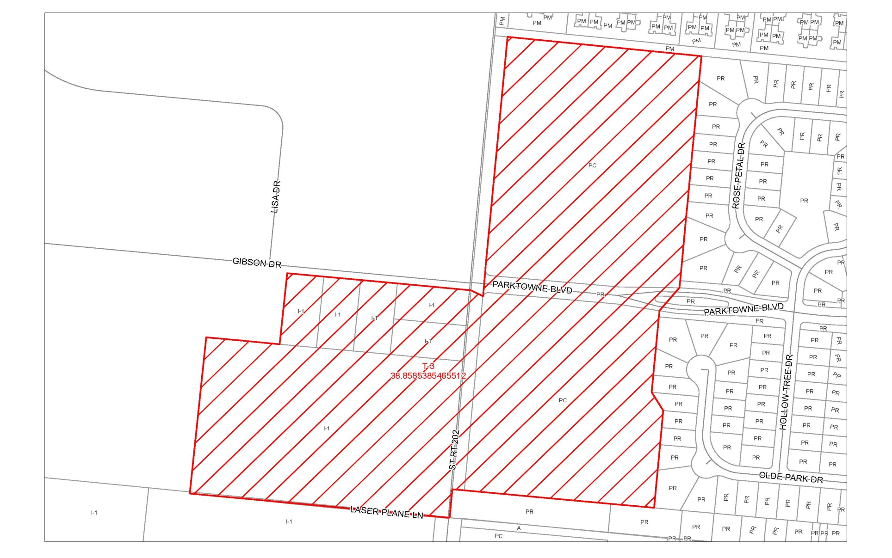
Proposed TIF District
12

Slide 12
Part 2 (cont’d)
It is estimated this new TIF will generate new revenue that will pay approximately ½ of the costs necessary to fund the construction of the new fire house.
Remaining portion of fire house funding will be provided by the Carriage Trials TIF. The City can designate the new fire house as a project that benefits all of our TIF districts but in particular those located in Miami County.
13

Slide 13
Part 2 (cont’d)
New TIF will generate 1.9 million over 30 years in new revenue assuming a 70/30 TIF for 30 years- (same as Trimble TIF) and 10 million in new construction value within the district.
The City will need to propose the TIF to Bethel Schools and arrive at a mutually agreeable revenue sharing agreement.
Debt service on new firehouse at 2 million in construction cost is approximately $153,000/year for 20 years
Will need to use approximately $50,000 to $75,000/ year of Carriage Trails TIF to help fund new firehouse depending on interest rates and the school compensation agreement.
14

Slide 14
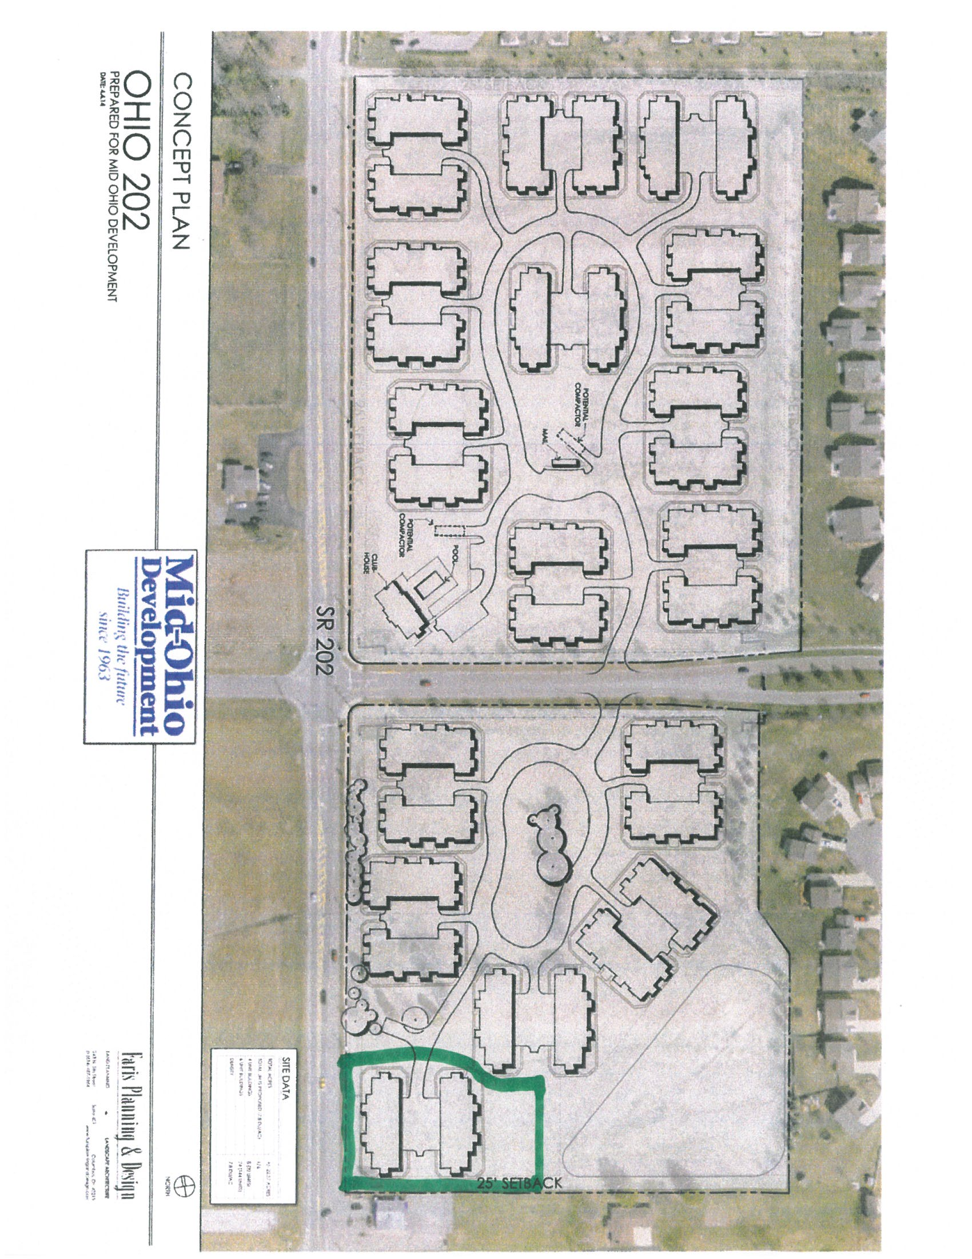
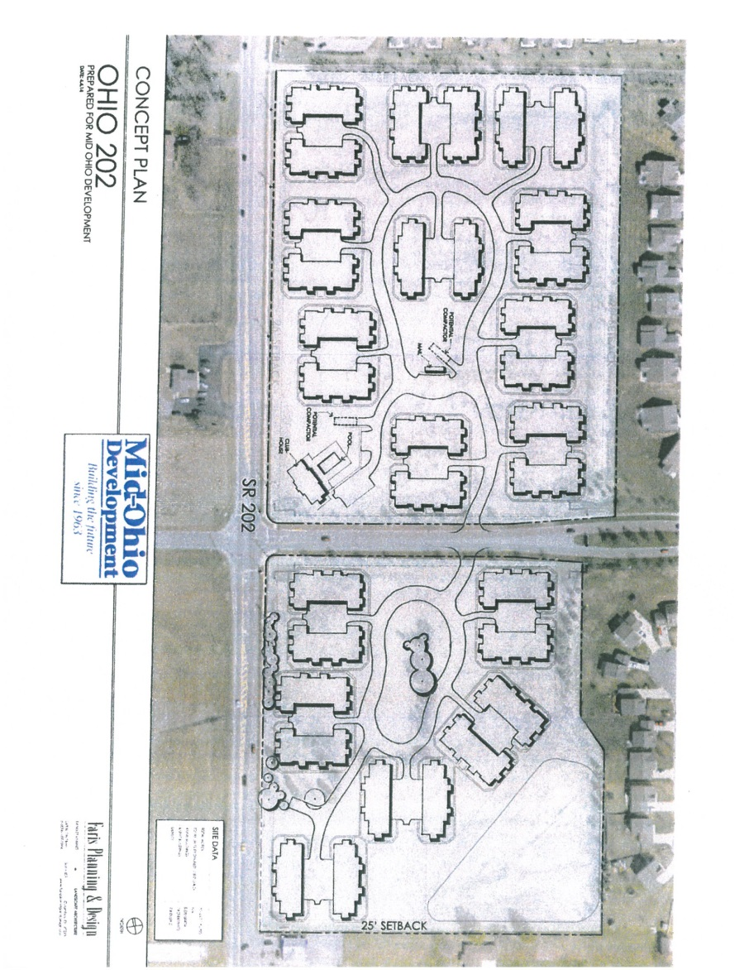
15

Slide 15
Council Action
City Administration to present proposal to Bethel Schools to work out agreement benefiting schools and TIF.
Create New TIF as agreed.
Work with the developer at Parktowne to build a firehouse while they build their project and build a fire house building that fits into their plans.
Grant Zoning to new developer
Designate fire house project as a TIF funded project benefiting all TIF districts but at minimum Miami County TIF Distircts.
16

Slide 16
Part 3
Improve the City’s debt position and reduce risk by loaning non-operating surplus balances in water, sewer, storm, and road funds ( Not Local Income Tax supported Street Funds) to the Capital Funds via the Carriage Trails TIF Fund to expand future public infrastructure at Carriage Trails and to pay off existing notes associated with the TIF portion of public infrastructure.
16

Slide 17
TIF Funds
MUSIC CENTER
FIRE HOUSE
AQUATIC CENTER
1

Slide 18
TIF Funds
Water
Sewer
Street
Storm
Funds
$
$
OK
$
$
$
Carriage Trails
Public Infrastructure
-Water
-Sewer
-Streets
-Storm
MUSIC CENTER
FIRE HOUSE
AQUATIC CENTER
2

Slide 19
TIF Funds
Water
Sewer
Street
Storm
Funds
$
$
OK
$
$
x
$
Carriage Trails
Public Infrastructure
-Water
-Sewer
-Streets
-Storm
MUSIC CENTER
FIRE HOUSE
AQUATIC CENTER
3

Slide 20
TIF Funds
Less restrictive
Water
Sewer
Street
Storm
Funds
$
$
$
OK
$
x
$
Carriage Trails
Public Infrastructure
-Water
-Sewer
-Streets
-Storm
MUSIC CENTER
FIRE HOUSE
More restrictive
AQUATIC CENTER
x
x
x
4

Slide 21
TIF Funds
$
$
Other Funds
Advance to Capital Funds
Infrastructure
Water/ Sewer/Street/ Storm
$
MUSIC CENTER
AQUATIC CENTER
FIRE HOUSE
Pay Off
Pay Off
Pay Off
Pay Back
non-operating funds
Excess
Excess
Excess
Excess for other Public Projects
1

Slide 22
Part 3 (cont’d)
This will use monies earning less than 1% to pay off debt that will eventually need to be issued at over 4% netting 3% savings while freeing up Carriage Trails TIF funds supporting the existing notes associated with the TIF portion of public infrastructure.
17

Slide 23
Part 3 (cont’d)
Currently there are approximately $4.9 million in Carriage Trails notes that will need to be issued as bonds in the next year.
Additionally there is $900,000 in current expenditures that need to be funded.
We are recommending in the next appropriations ordinance to loan this $900,000 in funds from the non-operating funds to the Carriage Trails TIF infrastructure fund
Not issuing this nearly 6 million as bonds will save the City approximately 180,000 per year in net interest (3%)
18

Slide 24
Part 3 (cont’d)
Since Carriage Trails TIFs is no longer supporting this 6 million in debt, this frees up its cash flow to support the facilities projects that benefit it.
Other non-operating funds may be necessary to be loaned over the original 6 million in order to support the plan in early years. However, all of these loaned funds will be repaid as part of the financial plan. It will take approximately 10 years to be repaid.
Allocate the Aquatic Center debt service, approximately $560,000 per year, that is currently paid by the Montgomery County TIF to be repaid by the Carriage Trails TIF.
Based on past performance and current estimates of build-out, Carriage Trails TIF, plus the new Parktowne TIF will support the new fire house, the existing debt on Carriage Trails infrastructure, and the Aquatic Center debt.
19

Slide 25
Council Action
Once Council acts to create TIF and designate fire house project as a TIF project benefiting all TIF districts, remaining portion of debt payment may only need to have appropriations that advance funds from other non-operating funds.
We will not need to issue debt for Carriage Public Infrastructrue, TIF related.
Future Carriage Trails funding will include appropriations and advances as necessary rather than debt issues. These advances will be paid back as TIF funds are generated and it is estimated they will be paid back by 2025.
20

Slide 26
Part 4
Remaining TIF districts revenue will support the Music Center financing.
Using Carriage Trails TIF to fund the Aquatic Center means the City is no longer is relying on future build out to fund the Music Center.
Thus reducing the City’s risk in covering the future debt service of the Music Center
21

Slide 27
Part 5
Refunding the water fund debt provides additional savings that can be used to offset the a portion of the costs assumed by water fund as a result of these some of proposals.
Savings to annual debt service to water fund is approximately $50,000/year
Refinance the current fire house debt to reduce the necessary amount needed in Fire Capital. Pending bond council approval interest saving will be approximately 3% per year.
22

Slide 28
Council Action
Issues bonds as necessary
23

Slide 29
Part 6
Continue the process of allowing special assessment funding at Carriage Trails and continue the current notes into final bonds.
Rolling notes for 2 years and then issuing bonds as required.
Currently approximately $900,000 special assessment notes to continue to roll forward.
24

